Slide 1
All about git
Performed by student
group RPZ-13a
Kateryna Hranat

Slide 2

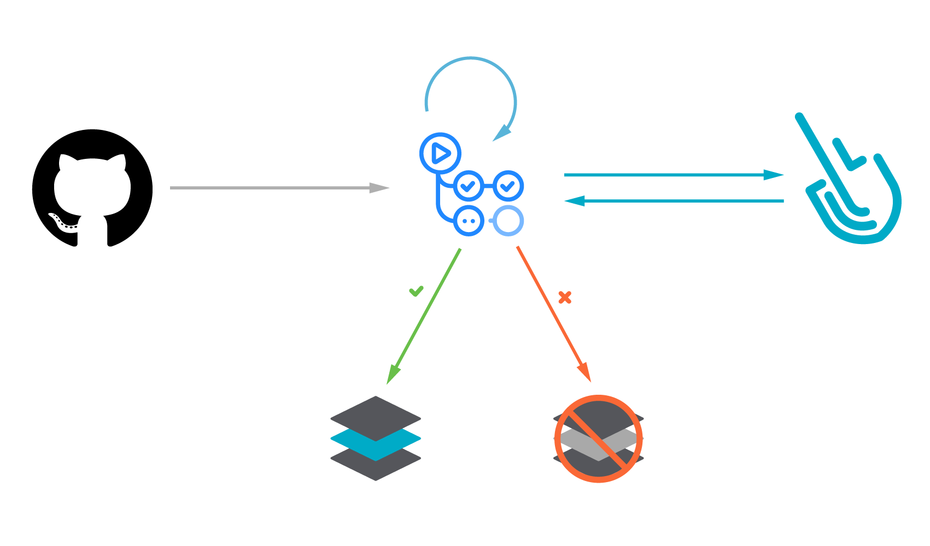
Git is a distributed version control system designed for tracking changes in source code during software development. It allows multiple developers to collaborate on projects simultaneously while maintaining a complete history of changes.

Slide 3
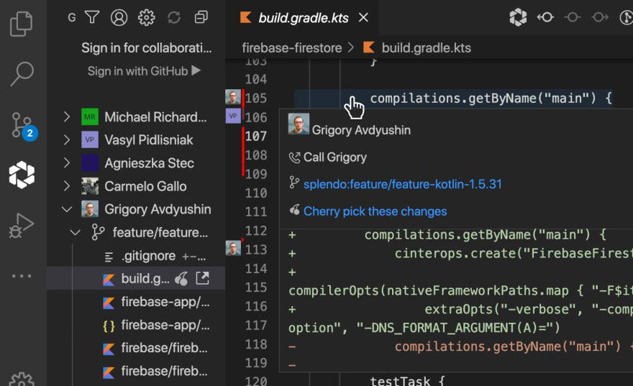
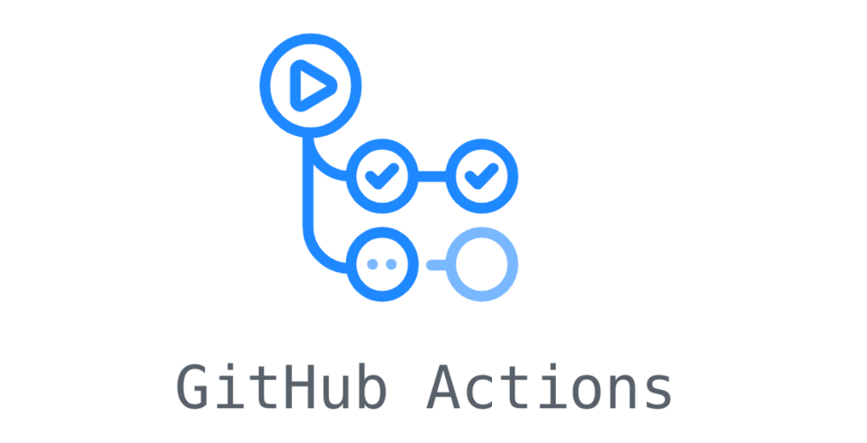
Git is primarily used for:
Version Control: It tracks changes to source code files over time, allowing developers to revert to previous versions, compare changes, and collaborate effectively.
Collaboration: Multiple developers can work on the same project simultaneously by branching off from the main codebase, making changes independently, and later merging those changes back into the main codebase.
Backup and Recovery: Git provides redundancy by storing the entire history of a project, enabling developers to recover lost code or revert to a stable state if necessary.

Slide 4

How Git Works:
Git operates locally on a developer's machine and does not necessarily require a constant internet connection. It follows a three-step process:

Slide 5
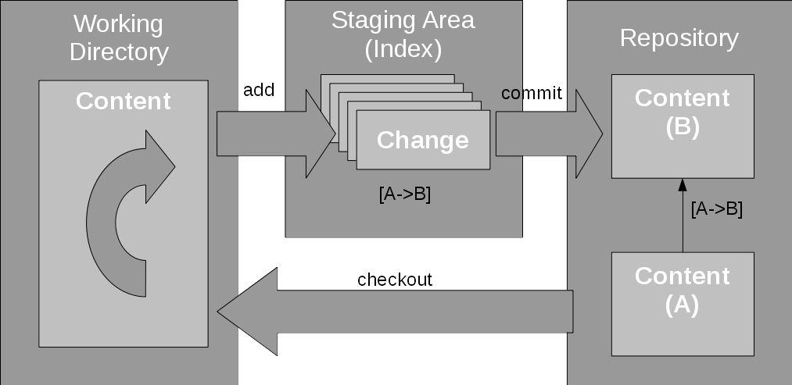
Working Directory: Developers make changes to files in their working directory.
Staging Area (Index): Modified files are staged, indicating which changes will be included in the next commit.
Repository: Staged changes are committed to the repository, creating a new snapshot of the project's state.

Slide 6

Git uses branches to facilitate parallel development. Developers can create separate branches to work on specific features or fixes, keeping the main codebase unaffected until changes are ready to be merged.

Slide 7
Advantages And Disadvantages

Slide 8

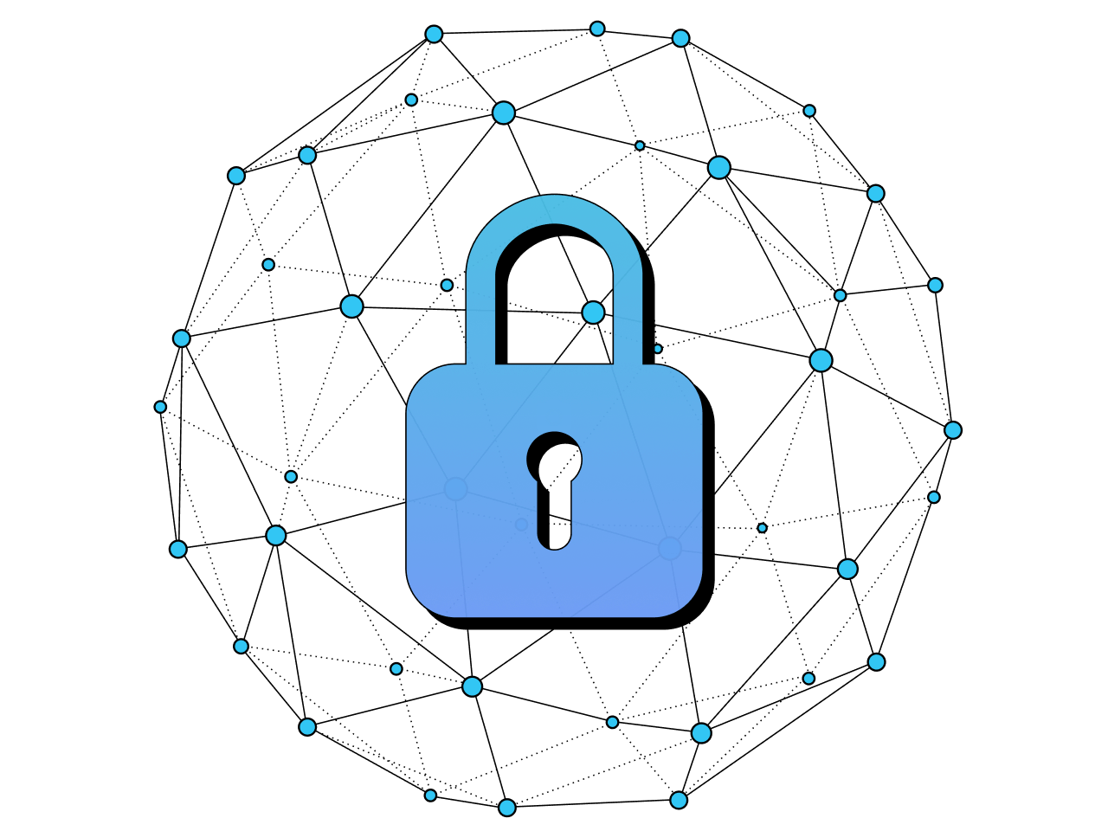
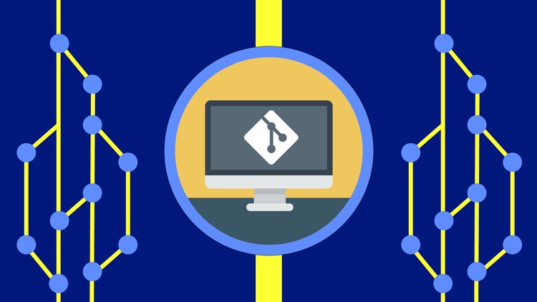

Advantages:
Distributed: Each developer has a local copy of the entire project history, enabling them to work offline and facilitating collaboration.
Fast: Git's lightweight design ensures speedy performance, even with large codebases.
Branching and Merging: Branching is easy and allows for parallel development, while merging facilitates the integration of changes.
Security: Git provides cryptographic integrity checks to ensure the authenticity and integrity of code changes.

Slide 9
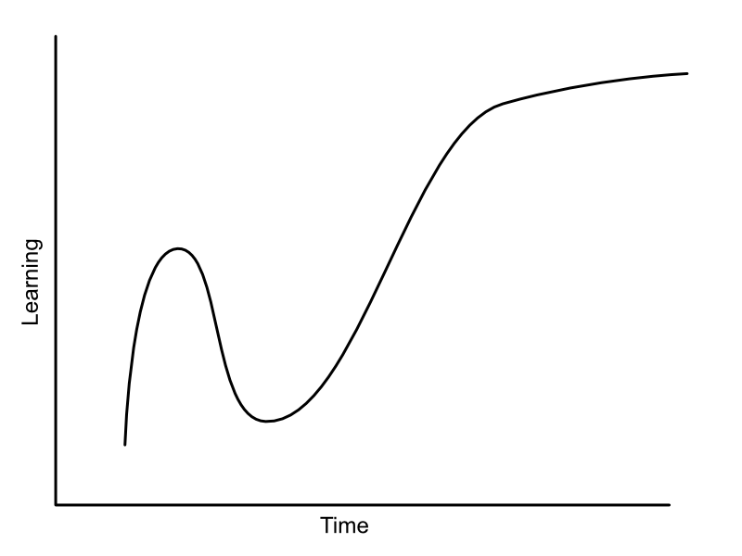

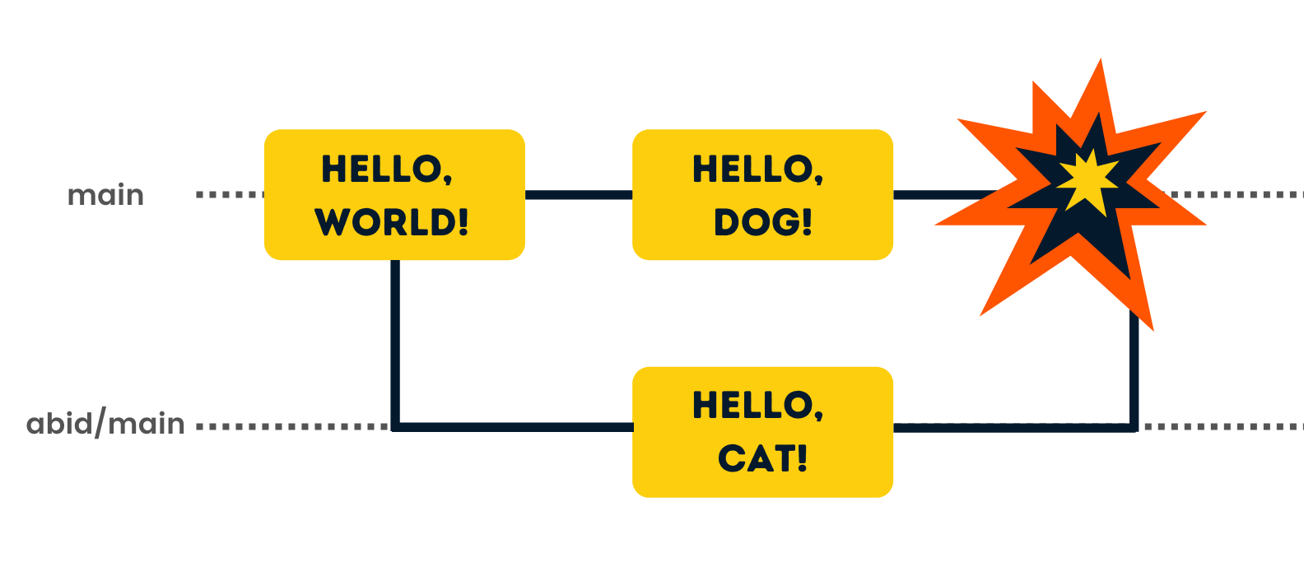
Disadvantages:
Learning Curve: Git has a steep learning curve, especially for beginners, due to its powerful but complex feature set.
Merge Conflicts: When multiple developers make conflicting changes to the same file, resolving merge conflicts can be challenging and time-consuming.
Initial Setup: Setting up and configuring Git repositories and workflows may require initial effort and expertise.

Slide 10
Interesting Facts:
Git was created by Linus Torvalds in 2005 for managing the Linux kernel development.
The name "Git" is British slang for a foolish or unpleasant person, chosen by Torvalds as a pun.
GitHub, a popular platform for hosting Git repositories, was founded in 2008 and acquired by Microsoft in 2018.
Git is used not only for software development but also for managing configurations, writing books, and even tracking changes in legal documents.

Slide 11
Commit in Git:

Slide 12
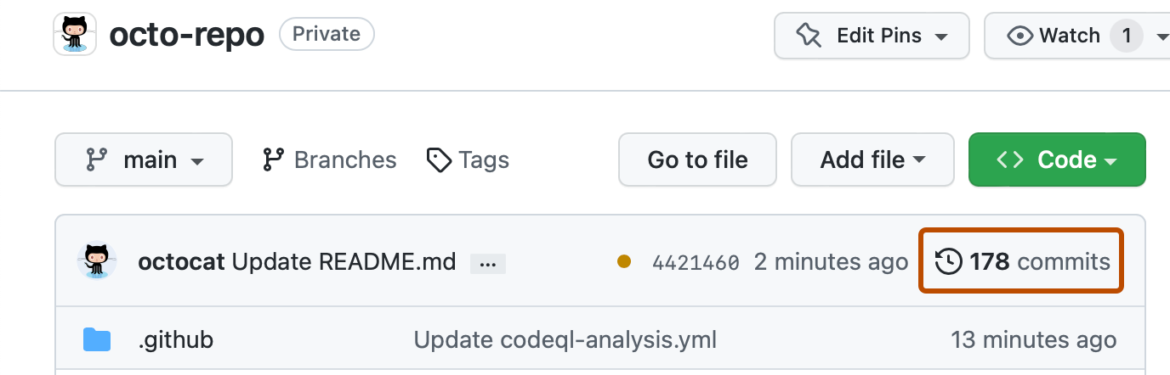
A commit in Git refers to a snapshot of the project's state at a specific point in time. It represents a set of changes made to the files in the repository since the last commit. Each commit has a unique identifier called a hash or commit ID, which is generated based on the contents of the commit and its parent commit(s).

Slide 13
Components of a Commit:
Commit Message: A descriptive message summarizing the changes introduced by the commit. It should be concise yet informative, providing context to other developers about the purpose and scope of the changes.
Author and Timestamp: The name and email address of the author who made the commit, along with the timestamp indicating when the commit was created.
Changes: The actual modifications made to the files in the repository. This includes additions, deletions, and modifications of lines of code or content.

Slide 14
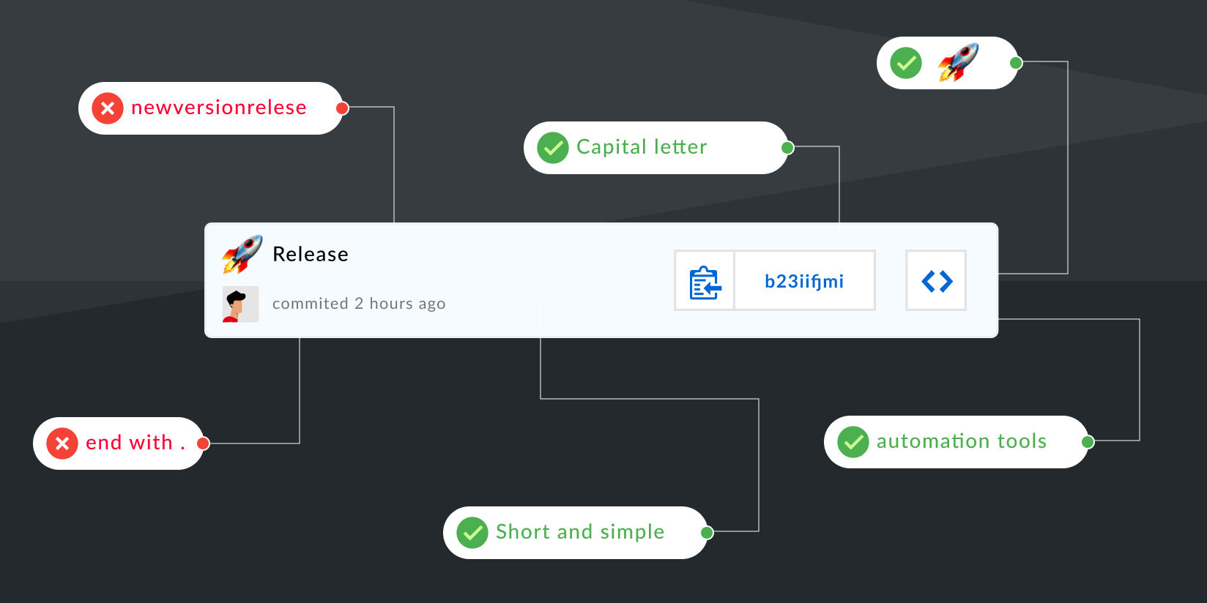
Purpose of Commits:
Version History: Commits form the version history of a project, allowing developers to track changes over time and understand the evolution of the codebase.
Reproducibility: Commits provide a means to reproduce previous states of the project, enabling developers to revert to a stable version or debug issues by isolating changes introduced in specific commits.
Collaboration: Commits facilitate collaboration among developers by providing a structured way to share and review changes. Each commit represents a logical unit of work that can be independently discussed, reviewed, and merged into the main codebase.

Slide 15
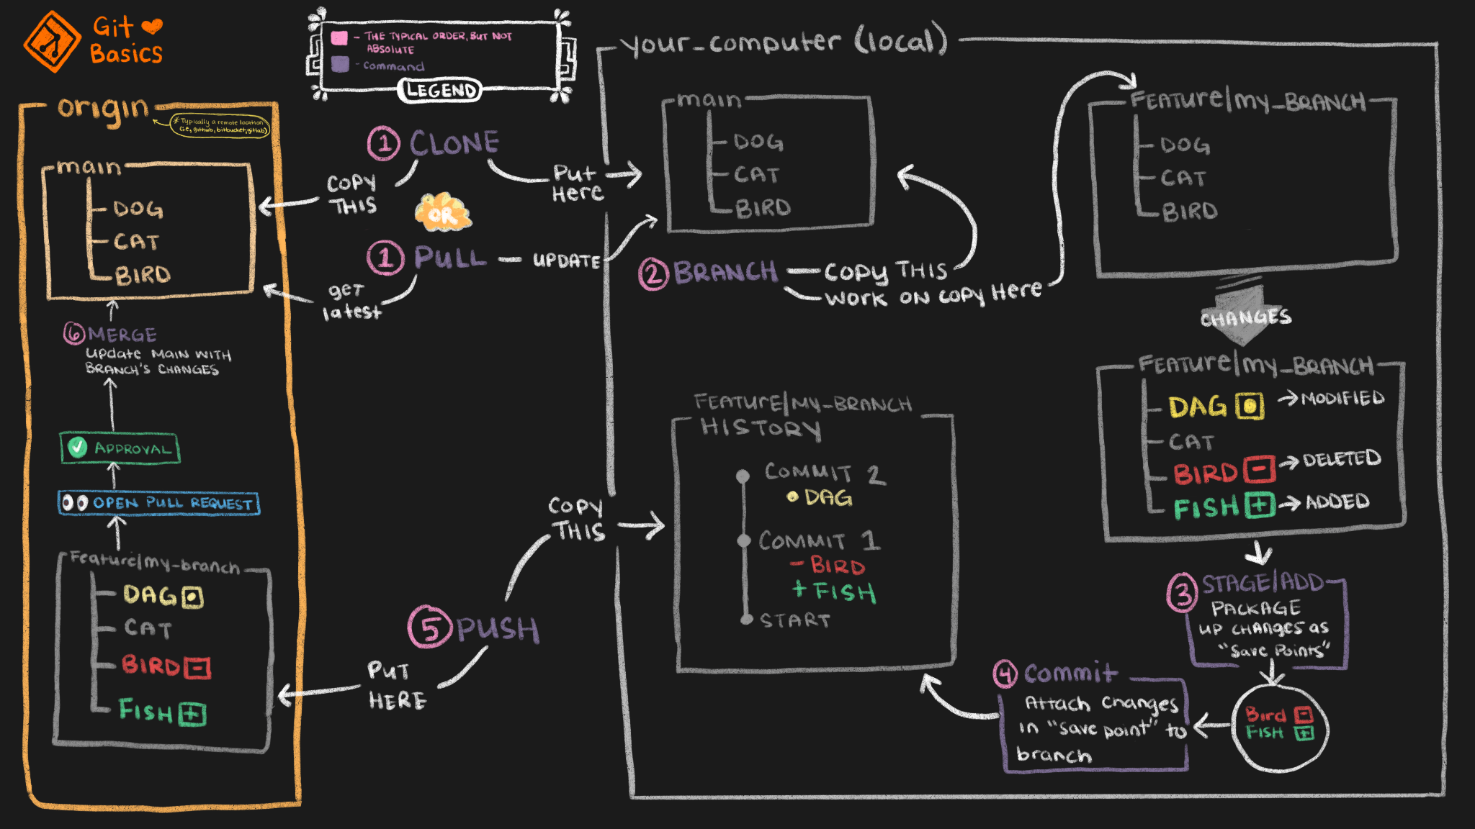
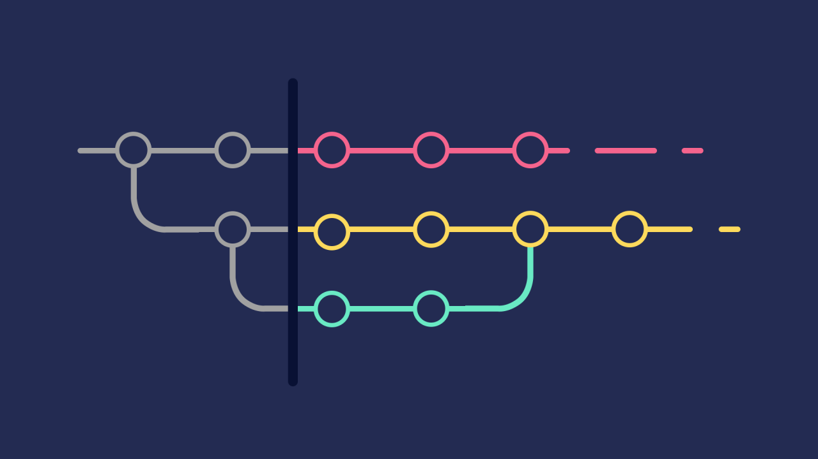
Commit Workflow:
Staging Changes: Before committing, developers stage the changes they want to include in the commit using the git add command. This allows for selective inclusion of modifications and helps organize changes into logical units.
Creating a Commit: Once changes are staged, developers use the git commit command to create a commit. They provide a commit message describing the purpose and context of the changes.
Viewing Commit History: Developers can view the commit history of a project using commands like git log, which displays a list of commits along with their metadata and commit messages.

Slide 16
In summary, a commit in Git captures a snapshot of the project's state at a specific moment, including changes made to files, metadata such as author and timestamp, and a descriptive message. Commits play a crucial role in version control, collaboration, and maintaining a structured development workflow.

Slide 17
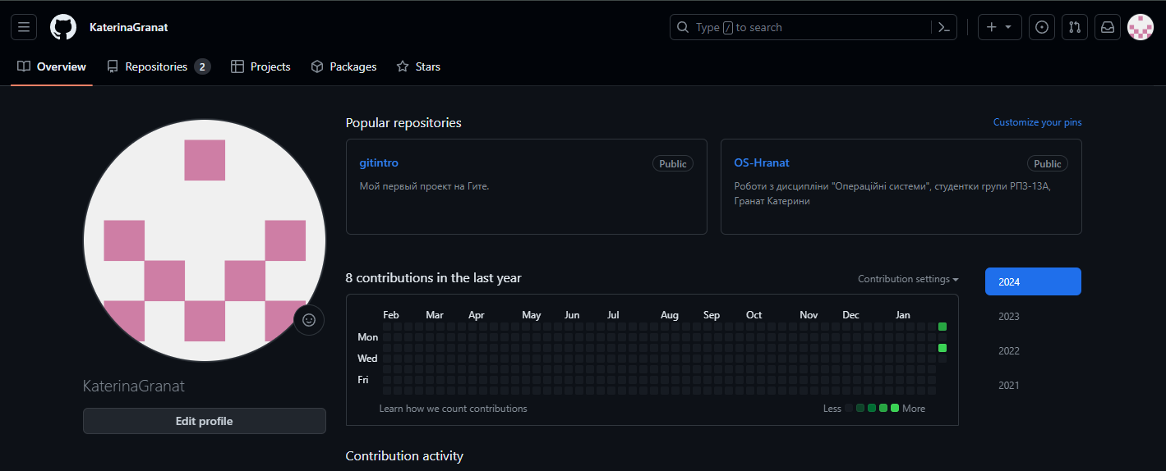
My account on git

Slide 18
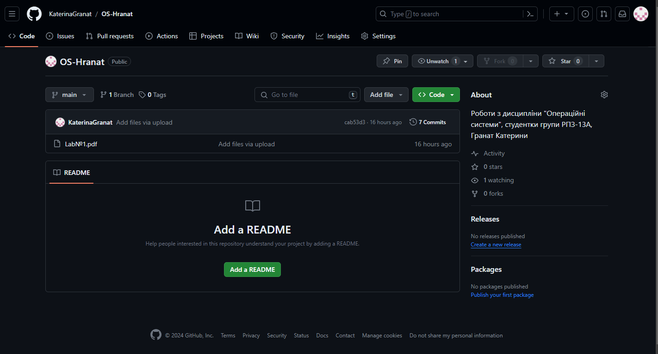
My public repository

Slide 19

Conclusions:
Git provides essential tools for efficient software development, including version control, collaboration, and project management.
Commits, as fundamental units in Git, play a pivotal role in documenting changes, enabling reproducibility, and facilitating collaboration among developers.
Understanding Git fundamentals and committing best practices are crucial for maintaining project integrity and fostering effective teamwork in software development endeavors.
Author – Kateryna Hranat

Slide 20
Thank you for attention!

